Slide 1
gRPC
Version 1.0 – November 2019
André Borges

Slide 2

A high-performance, open-source universal RPC framework
Built with modern technologies
Was originally pioneered by a team at Google
Backed by Cloud Native Computing Foundation project
HTTP/2
Protocol Buffers

Slide 3
Protocol Buffers
Protocol buffers are a flexible, automated mechanism for serializing structured data. It encourages a Contract-First API development, allowing for language agnostic implementations
Service Model
Service method and structure of the request and response.
IDL (Interface Definition Language)
Describe once and generate interfaces for any language
“Single source of truth“
All we have to share with others in order for them to know exactly how to cal our services and what to expect back

Slide 4
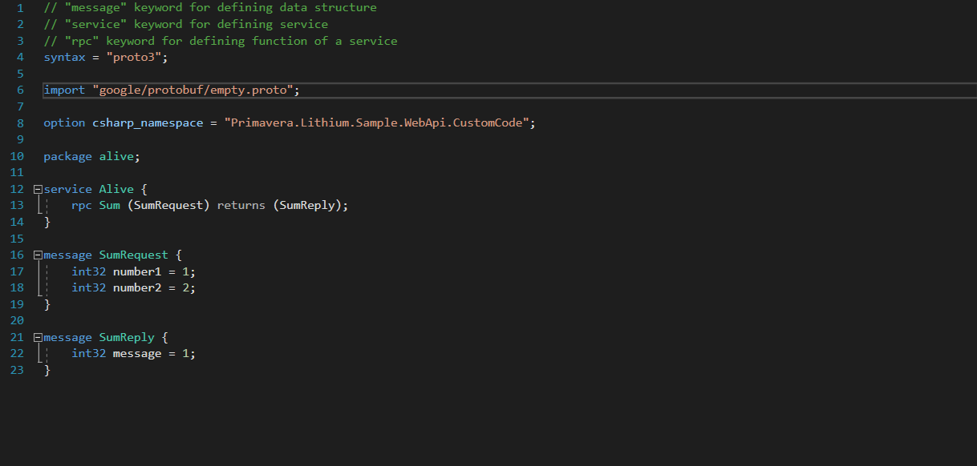
Protocol Buffers Example

Slide 5
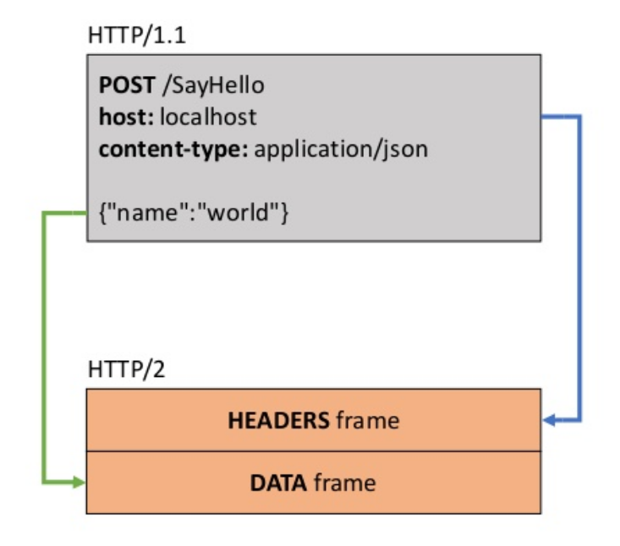
HTTP2
HTTP/2 binary framing and header compression (HPACK)
HTTP/2 uses the concept of connections and streaming

Slide 6
HTTP2 Demo
http://www.http2demo.io/

Slide 7
Strengths
Low internet usage
HTTP/2 binary framing and header compression (HPACK)
Protobuf Message Serialization (JSON takes a lot longer to serialize/deserialize)
Code-generation
All gRPC libraries have first-class code generation support so it is possible to use multiple languages
Streaming
gRPC uses HTTP/2 to enable streaming
Unary Streaming
Server Streaming
Client Streaming
Bi Directional Streaming
HTTP/2 multiplexing
Multiple calls calls via a TCP connection
Avoid head-of-line blocking

Slide 8
Weaknesses
Limited browser support
Browsers have great HTTP/2 support, however JS APIs haven’t caught up and gRPC-web provides limited support for calling gRPC services
Not human readable
HTTP/2 and protobufs are binary protocols
Sometimes additional tools like BloomRPC and Wireshark are required to debug calls
There’s no standardization across languages

Slide 9
REST APIs
Easy to understand (text protocol)
Web infrastructure already built on top of HTTP
Great tooling for testing, inspection, modification
Loose coupling between clients/server makes changes (relatively) easy
High-quality HTTP implementation in every language
No formal (machine-readable) API contract
Collary: writing client libraries requires humans
Streaming is difficult (night-impossible in some languages)
Bidirectional streaming is not possible at all
Inefficient (textual representations are not optional for networks)
Hard to get many resources in a single request (GraphQL)

Slide 10
GRPC vs REST APIs
gRPC is Contract First (proto file)
HTTP APIs are Content First (URLs, method, JSON)
On the gRPC the contract is designed for humans
On HTTP APIs the content is designed for human
gRPC hides the remoting complexity
HTTP APIs emphasise HTTP

Slide 11
These characteristics make gRPC ideal for
Lightweight microservices where efficiency is critical
Polyglot systems where multiple languages are required for development
Point-to-point real-time services that need to handle streaming requests or responses

Slide 12
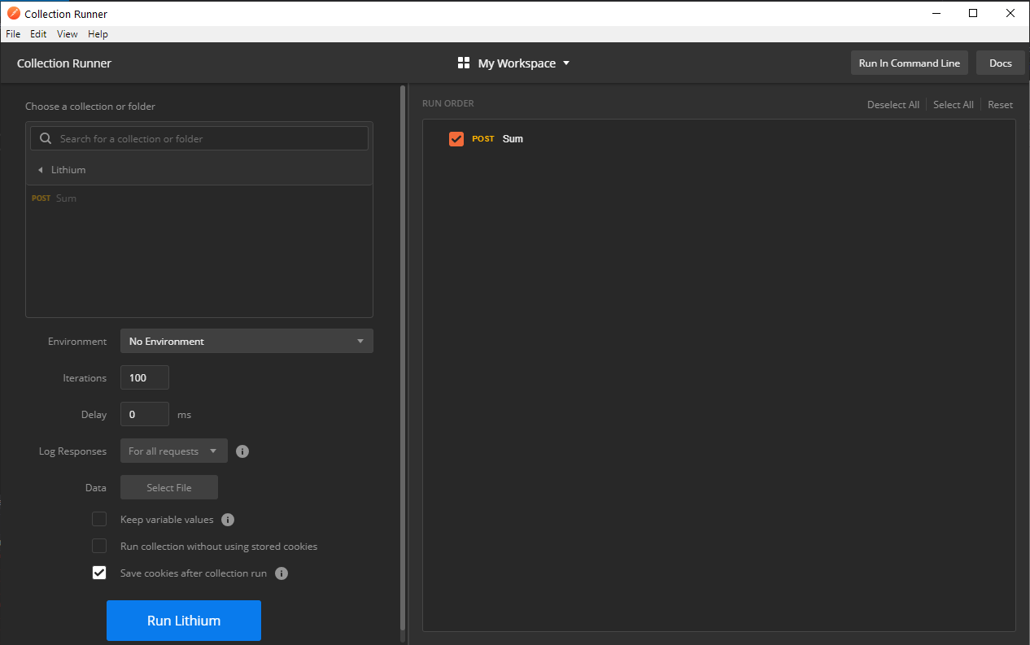
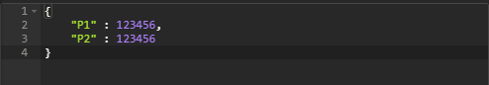
REST vs GRPC – Practical Benchmark

Slide 13
REST – Average 97.43ms

Slide 14
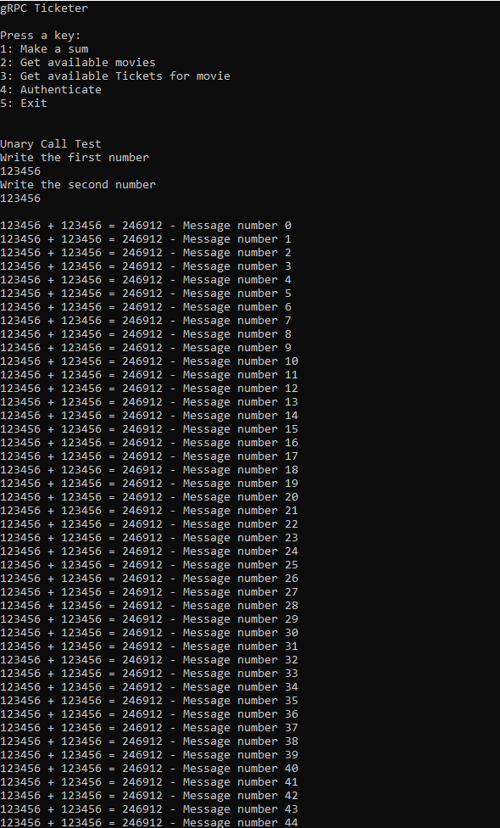
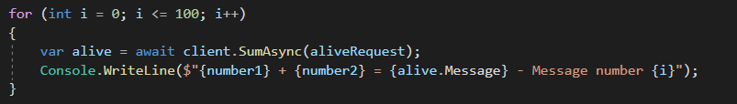
GRPC

Slide 15
GRPC - Average 3.70ms

Slide 16
Is it worth the migration yet?
Migration is hard and require time and costs
It is currently hard to implement the HTTP/2 gRPC spec on the browser, as there is simply no browser API with enough fine-grained control over the request
There are currently some issues with gRPC and macOS

Slide 17
THE END

